Slide 1
Airline Safety
Are flights safer today than they were 30 years ago?

Slide 2
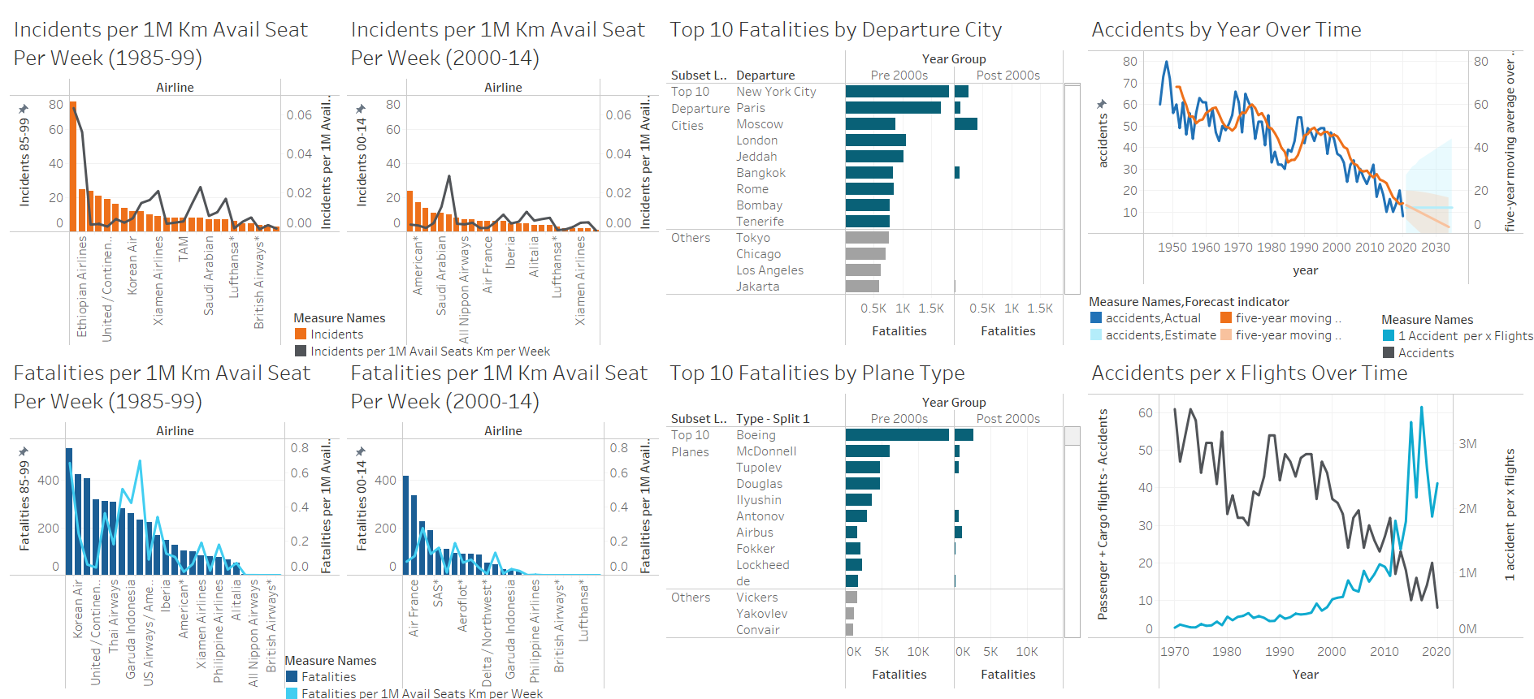
Number of Accidents over time
There is a clear downward trend in accidents over time
Planes/flights becoming safer and safer as new technology and regulations improve
Forecast suggests even better improvements in the decades to come

Slide 3
Accidents per x number of flights over time
There is a clear downward trend in total accidents over time
The accidents per x flights shows that there are less accidents as well as less frequency of accidents

Slide 4
Incidents by airline pre-2000s vs post-2000s
The total number of incidents has decreased in the more recent 14 years
There is also a reduction in the number of incidents per 1M Km Available Seats Per Week

Slide 5
Fatalities by airline pre-2000s vs post-2000s
The total number of fatalities also has decreased in the more recent 14 years
There is also a very large reduction in the number of fatalities per 1M Km Available Seats Per Week

Slide 6
Top 10 Fatalities by departure city
The number of total fatalities has decreased Post-2000s
Some of the top 10 departure cities historically had most of their fatalities Pre-2000

Slide 7
Top 10 Fatalities by Plane type
Boeing plane types have the most fatalities historically, but they also are one of the most popular plane types
The number of total fatalities has decreased Post-2000s

Slide 8
Conclusion
The number of accidents and fatalities are down over time as well as the frequency of these events
This can be leveraged to show that the industry has improved in safety as time has gone on
Accident and fatality frequency historically dependent on airline, plane type, and where the flight is leaving from/going to
This can be leveraged to show that our company is safer than others
Ethical concerns:
Attacking another airline or plane manufacturers to boost our results
Visualizations don’t consider the number of flights/frequency for “Departure City” and “Plane Type” slides
What are our biggest takeaways?

Slide 9
Thank you

